Slide 1

Automated Customer Reviews by
GROUP 4
Maria Eduarda Sandra Sofia Tiago

Slide 2
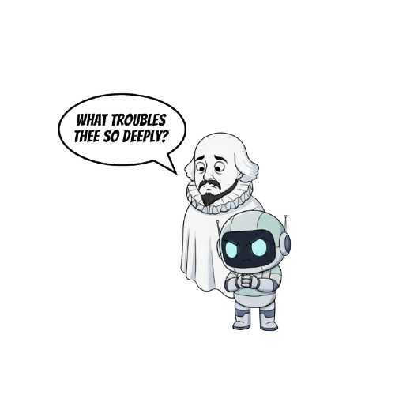
“The pitch”
Automated Product Reviews — Because No One Wants to Read All That
We built a smart system that does the dirty work of online shopping: it reads all the customer reviews so you don’t have to.
Our model figures out which reviews are happy, angry, or neutral, groups products into categories, picks the crowd-favorites, and then tries its absolute best to summarize everything into something readable.
Does it write perfect summaries? …No. But it tries — and honestly, that’s already better than most customers.
Basically, we turned a mountain of chaotic reviews into a shopping shortcut. Your time is saved. Your sanity is saved. You're welcome.
(And yes… our summaries are not exactly Shakespeare yet —but they exist, and that’s what matters. 😅)

Slide 3
Introduction
Real-world problem: Companies get thousands of messy, unstructured reviews and product categories. It’s nearly impossible to know which products customers truly love and why without an automated system.
How the models fit together:
Model 1 (Sentiment Classifier): Labels every review as positive/neutral/negative.
Model 2 (Product Clustering): Groups products into 5 meaningful meta-categories.
Model 3 (Ranking + Summarization LLM): Uses outputs from both models to identify the top 3 products per cluster and generate human-friendly summaries of what customers say.
How model design choices affect each other:
Clean clusters → fair product comparison → better rankings.
Accurate sentiment labels → the LLM selects the right “top products.”
The LLM depends on high-quality outputs from Models 1 & 2 to generate correct and useful summaries.
Methodology : We built a 3-model pipeline that combines sentiment analysis, semantic clustering, and LLM summarization to automatically reveal and explain the best products in each category.

Slide 4
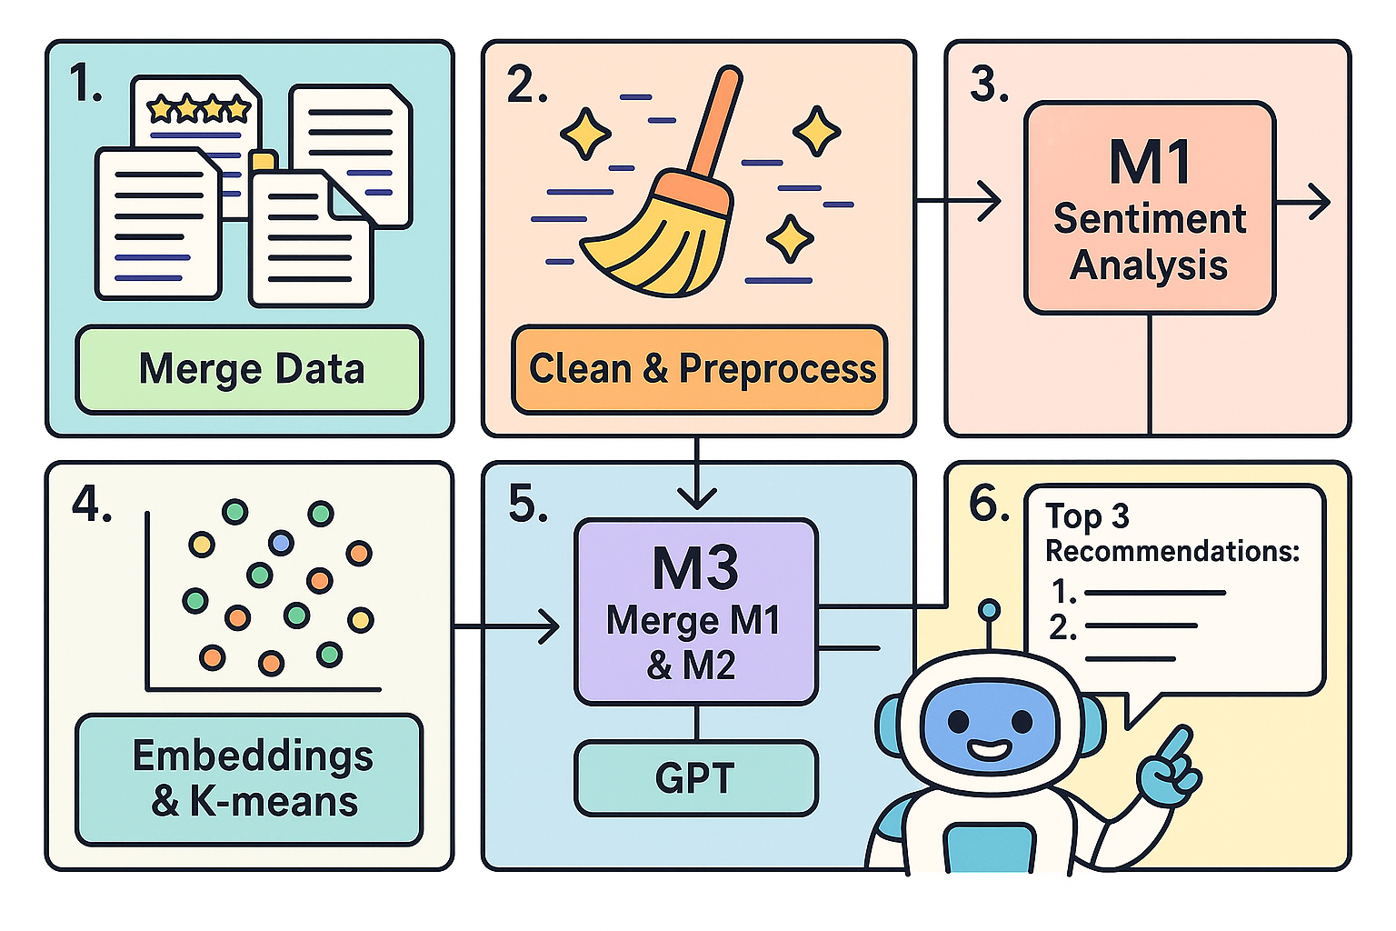
Our Pipeline
Three .csv files
Clean & Preprocessing:
Remove all unnecessary columns, duplicates + normalize and lowercase
3. Classifier:
Rebalanced with SMOTE
4. Clustering:
Sentence - Embeddings + KMeans
5. Using existing LLMs:
GPT/ FLAN T5 small/ BART

Slide 5
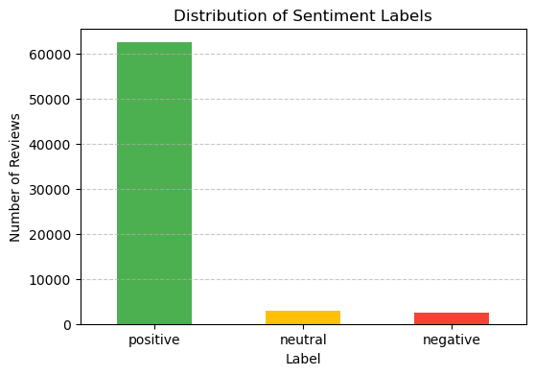
Model 1
Goal: Classify customer reviews into positive / neutral / negative to improve product insights. Steps:
Combined title + text → cleaned text (lowercase, remove HTML/URLs).
TF-IDF (1–3 grams, 50k features) to convert text into signals.
LinearSVC with balanced classes for stronger generalization.
Why it works:
TF-IDF captures important words + short phrases.
LinearSVC handles high-dimensional text very well.
Stratified split + balanced classes reduce bias.

Slide 6
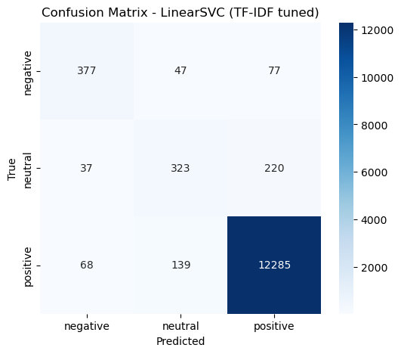
Model 1 - Evaluation
Evaluation:
Good performance on positive/negative; neutral harder (expected).
Confusion matrix shows most confusion happens around neutral.

Slide 7
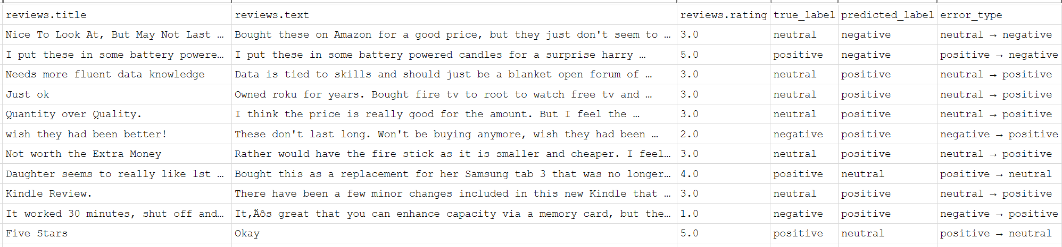
Model 1 - Evaluation
Error Inspection:
Misclassified samples often ambiguous (“ok”, “works fine”, mixed sentiment).
Some reviews too short or sarcastic → hard even for humans.

Slide 8
Model 2 - K-Means & Sentence Embeddings on Category
⭐Goal: Reduce hundreds of Amazon product categories into 5 meaningful meta-categories so the summarization model can generate one article per category.
What We Tested
We ran 4 clustering experiments, combining:
TF-IDF (unigrams/bigrams)
Dimensionality reduction (SVD)
Sentence embeddings (all-MiniLM-L6-v2)
K-Means (k = 5)
Each experiment used different combinations of product name, brand, and category text.

Slide 9
Model 2 - K-Means & Sentence Embeddings on Category
Chosen Method: ⭐ K-Means on Sentence Embeddings of the category column only
✅ Why Embeddings Win
Capture meaning (e.g., “Bluetooth speaker” ≈ “wireless speaker”)
Ignore irrelevant noise (codes, product IDs)
Produce tight, human-readable groups
Cleaned the categories column
Split on commas
Removed extra spaces
Rejoined into a single text string
Converted each product’s categories into embeddings
Model: all-MiniLM-L6-v2
Creates a 384-dimensional semantic vector per product
3. Ran K-Means with k = 5
Grouped similar category embeddings together
Each product got a category_cluster label

Slide 10
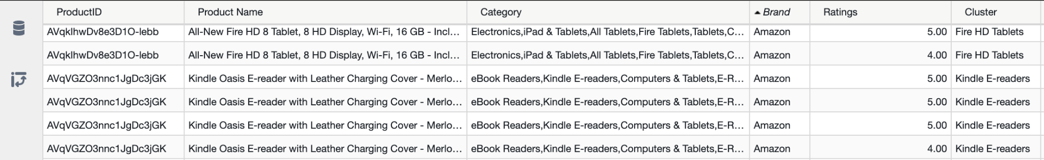
Model 2 - K-Means & Sentence Embeddings on Category
Chosen Method: ⭐ K-Means on Sentence Embeddings of the category column only
4. Manually named clusters
Based on top category terms and sample products:
Smart Home / Audio
Fire HD Tablets
Classic Fire Tablets
Batteries
Kindle E-readers

Slide 11
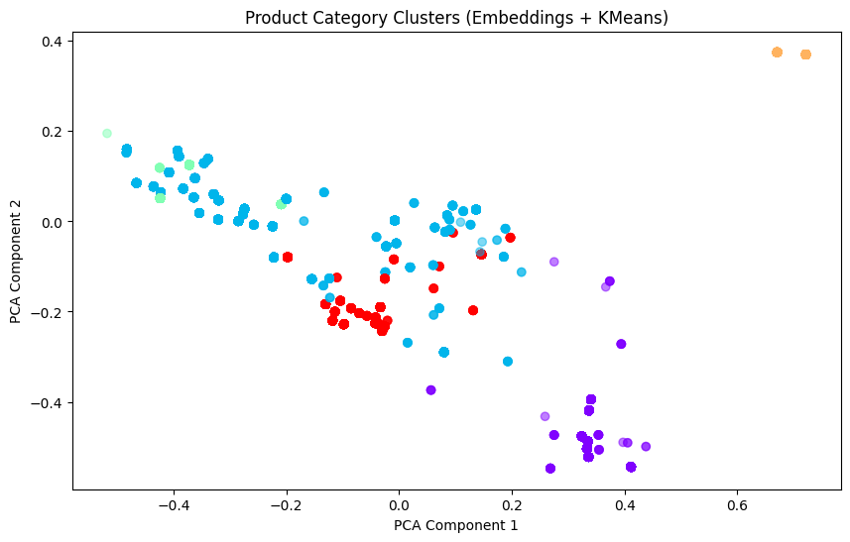
Model 2 - Evaluation
How We Evaluated
Visual inspection of cluster content
Manual validation of category coherence
Check if cluster names match real Amazon ecosystems
Why It Makes Sense
“Fire Tablets” and “Kindle” devices group naturally
“Batteries” consistently isolated
Smart-Home products cluster around Alexa ecosystem
Result
➡️ Clean, interpretable, stable clusters suitable for generating summaries.

Slide 12

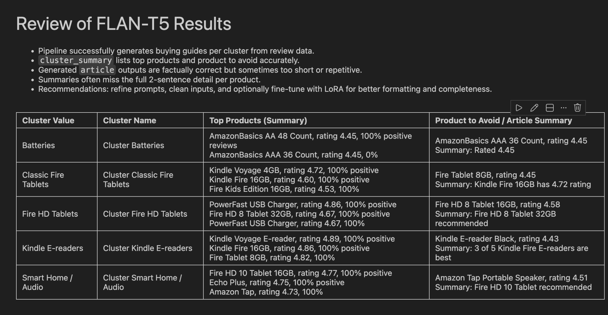
Model 3: FLAN T5 small
We chose this model because it is instruction-tuned, lightweight and supports text-to-text tasks like summarization and recommendation.
The output was not as expected and not satisfactory, so that we had tried different prompts and to fine tune with LoRA
The results were not optimized but rather getting worse to hallucinations etc.
We learned that the small FLAN T5 is ultra sensitive to:
Too strict rules and long prompts, complex instructions = It tended to repeat product names.

Slide 13
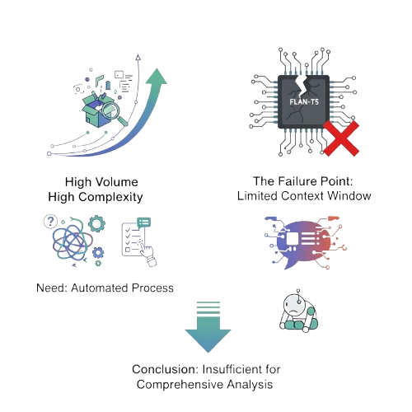

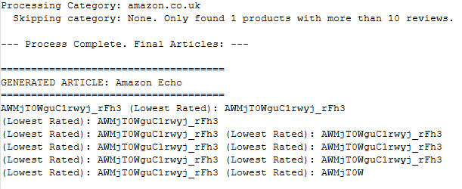
Model 3: GPT-3
The problem:
Too many unstructured reviews, high-volume data;
Creation of a single datafile generated from the outputs of previous tasks.
Initial trials started with FLAN-T5, failed due to limited context windows.
Handling text volume for comprehensive analysis and comparison.
FLAN output example:
GPT-3 was chosen to provide a different take on the problem.
*Another member was already working with a FLAN model and improving it.

Slide 14

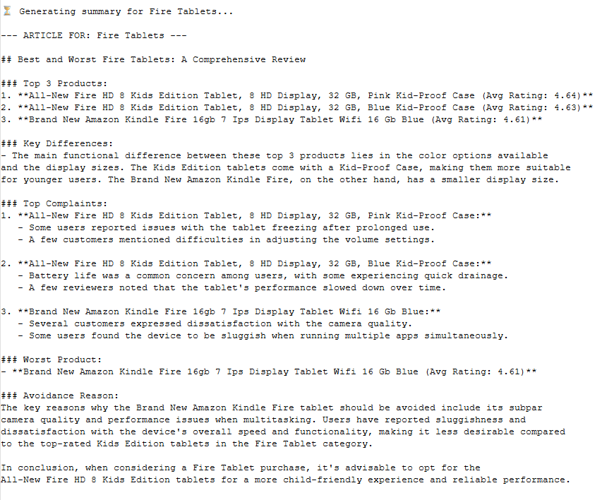
Model 3:
Model 3: GPT-3 - Evaluation
Picked GPT-3, larger context window, strong multi-step instruction handling
Pre-processed data in Python/Pandas to aggregate reviews
Comprehensive system prompt enabling the model to rank, compare, extract complaints, and generate a full article from the output

Slide 15
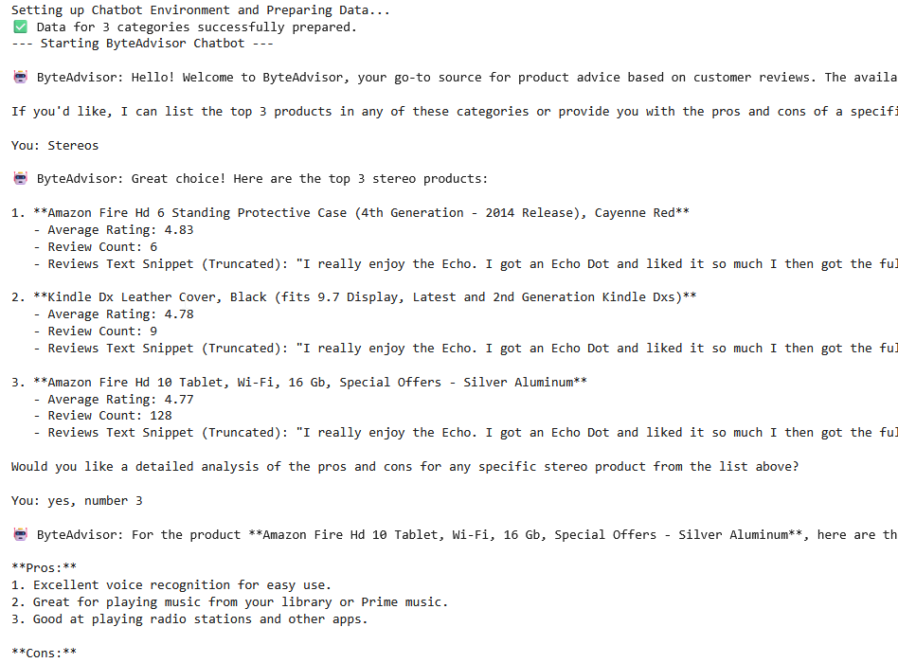
Model 3:
Model 3: GPT-3 - Extra
Chatbot output:
Experimented with building a chatbot based on Task 3 as a fun exploration
Designed the bot to answer only questions related to the review dataset
Intended use: provide guidance on which products to buy—or avoid—based solely on the reviews
This was not considered for the final presentation due to need several improvements(and more time) but it is worth mentioning.

Slide 16
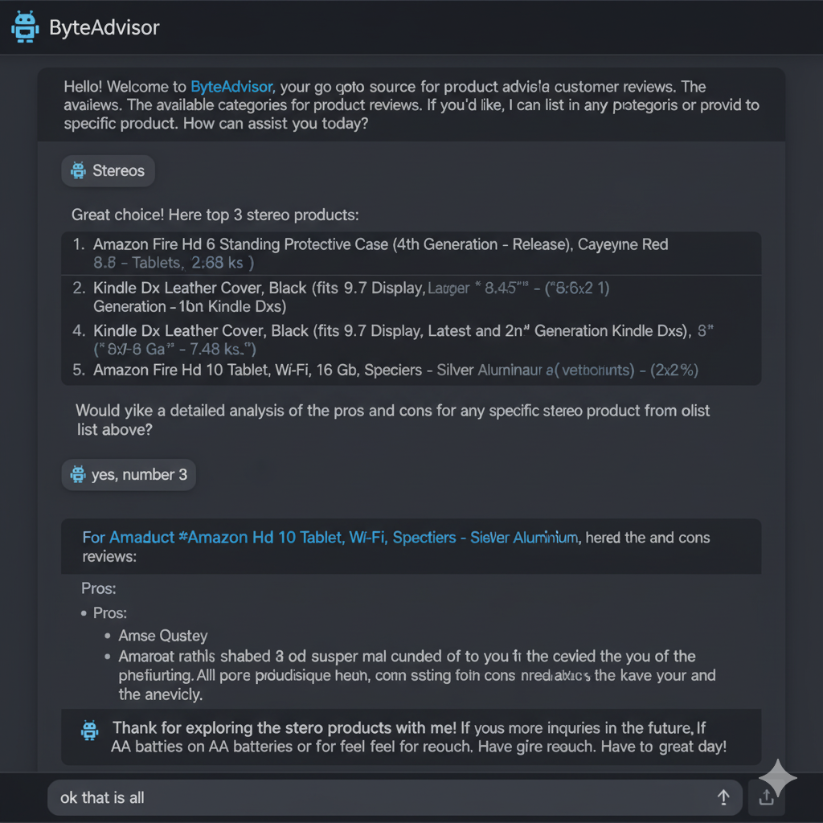

Model 3:
Model 3: GPT-3 - Extra
Chatbot output:
Well even though this was not considered to implement on the project for evaluation, we think it’s still worthy of an extra point!
Because if we had actually managed to complete it, it would be best chatbot ever, very beautiful, very nice!
Desired results
*Desired results image was AI generated.

Slide 17
Takeaway
If we could choose freely, we would stick with GPT-3 as our summarization model.
If we had to use an existing open-source LLM, our next choice would be FLAN-T5, fine-tuned with LoRa.
Finally, we also tested BERT, but it performed the least well for this task since it is blog-style articles
THANK YOU FOR YOUR PATIENCE 🖤

